Slide 1
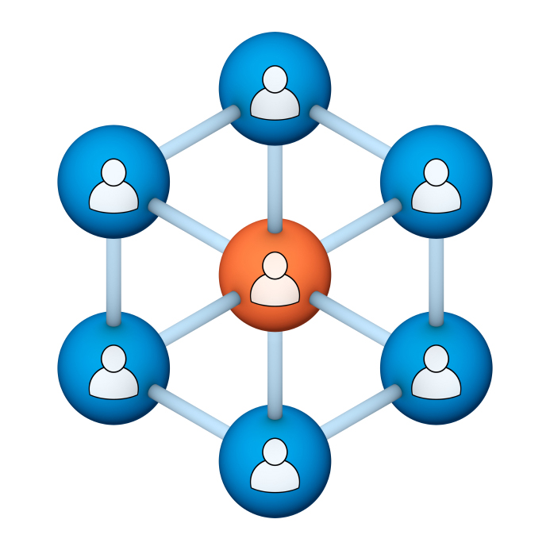
Administrators
Users Group
Meeting
5/15/19
Notes:
Welcome to the April 2019 Administrators Users Group Meeting!

Slide 2
Housekeeping
Using the Zoom navigation bar, click on Chat to send a question or comment:

Slide 3
Our Presenter
Chris Glenn, Client Services
CypherWorx, Inc.
Notes:
.

Slide 4
Customer Support
Brett McIntosh – bmcintosh@cypherworx.com
Christopher Schramm – cschramm@cypherworx.com

Slide 5
Agenda
Registration Overview
Training Videos
Admin Course Creation
Browser/Flash
What’s New!
Learning Paths
Site Building features breakdown
Events tip (After-Event Reporting)
http://en.wikipedia.org/wiki/Firefighting_in_the_United_States

Slide 6
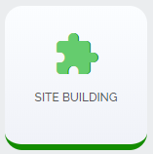
Registration
Importance of the URL/site link:
There are specific URLs for each site, and since the Redesign, different URLs for logging in and registering (new account creation).
Find the unique URLs for your site in Site Building, in the General section after you select the green shield from the menu at the left edge of your screen:

Slide 7
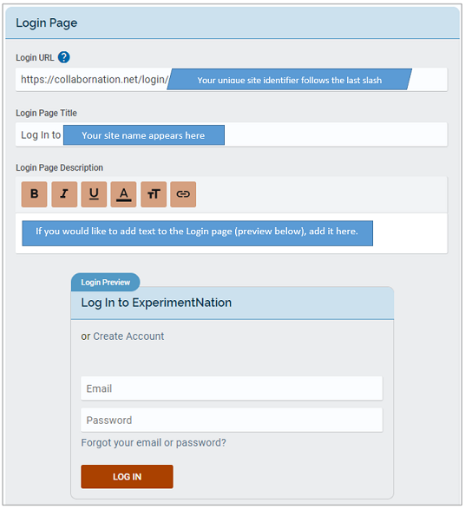
Login URL
After you select
you will see several sections and a “Save Changes” button underneath all of them.
Here is the Login Page section.

Slide 8
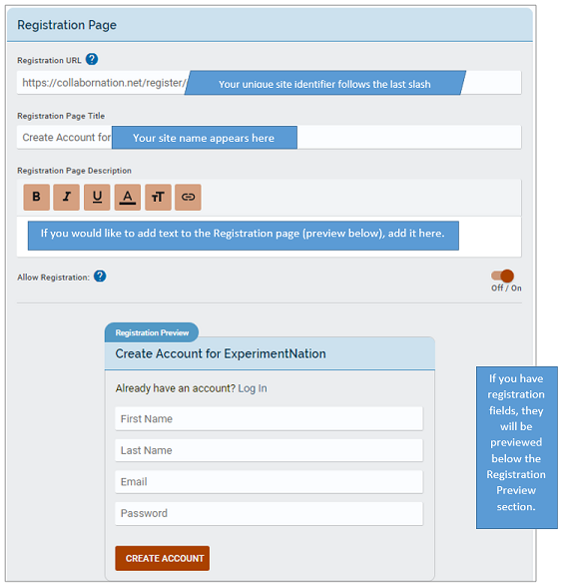
Registration URL
And here is the Registration Page section.
Remember, both the login URL and the registration URL will always begin with:
https://collabornation.net/

Slide 9
Training Videos
25:36 minute video
CollaborNation Site Redesign
A quick look at our site redesign
https://support.cypherworx.com/solution/articles/4000137266-collabornation-site-redesign
48:39 minute video
Admin Users Group Meeting – February 21, 2019
Mike Maether gives a tour of the redesign for Site Administrators
https://www.screencast.com/t/oaoysdg4ef
2:44 minute video
Maximize Employee Performance With Assessments
A quick look at our new Assessment Feature
https://www.youtube.com/watch?v=gi5qzVlPK2Q&t=34s
7:18 minute video
Learning Management System
Details how to take courses, participate in discussions, add events and upload resources. Admins can see how to use the reporting features, course assignment options and our DIY Course Creation tool.
https://www.youtube.com/watch?v=cOrfDxQdEY4
10:41 minute video
CollaborNation Create-a-Course (DIY) Tutorial
Details the step by step process on how to turn your existing material into an online course.
https://www.youtube.com/watch?v=cX4AXHe5Yak

Slide 10
Courses You Create
If you are creating your own courses using a course creation software such as Articulate Storyline or Articulate Rise and need us to load your course for you, we need to have the answers to the following questions.
Course title
Are there prerequisites (if there are, then they'd need to be supplied as well)
Is there an image that will show up when someone takes the course? Is so, I'll need that in jpg form.
What is the Course Availability? (This is how long - in weeks - a client has to take the course).
Course length (how long in hours)
Course Description
What catalog you want the course to go in?
If there is a test, what's the mastery score
If there is a certificate, does it need to populate on "passed" or "completed"
If there is a quiz, please provide me with the answers.
There is also an article in our support hub about using your own courses in your site:
How to create courses and upload them to your site

Slide 11
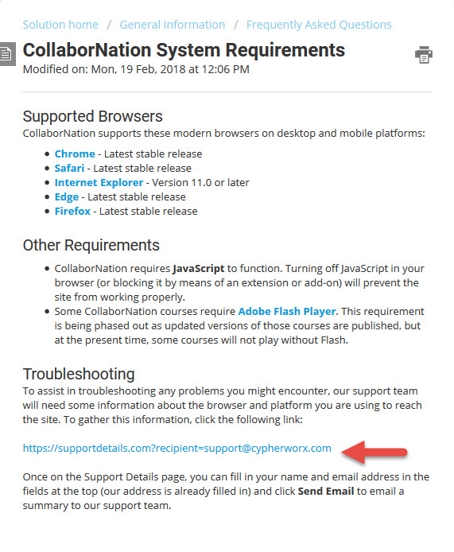
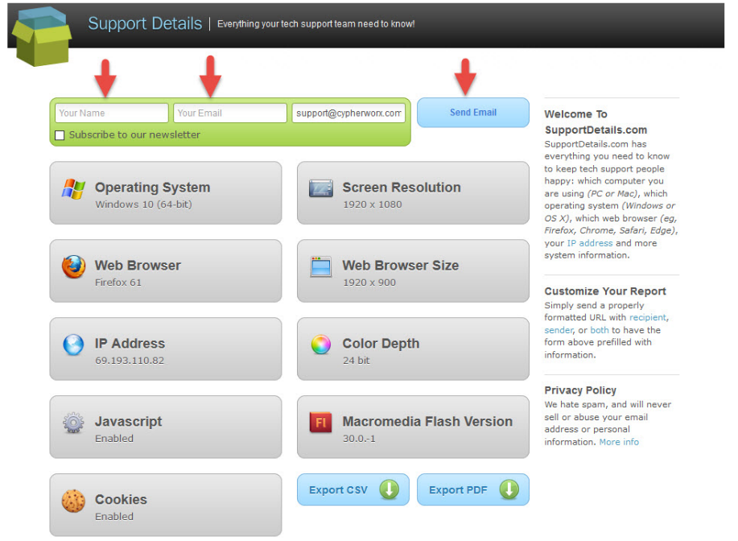
Browser/Flash Info
Visit the Support Hub to see the full article: CollaborNation System Requirements

Slide 12
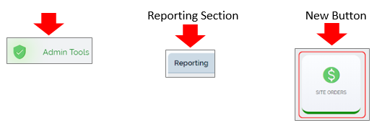
What’s New!
On 5/14/19, programming uploaded 2 new feature enhancements:
New in your assortment of Admin Tools is a Site Order tool in the Reporting section.
It displays any purchases made in the site, i.e. course or membership purchases. The overall page displays who purchased the course, their transaction number, order total, purchase type (course or membership), and the date of transaction. If you click on the transaction ID you can then see details of the order, such as the course that was purchased, or if a coupon was used. If a course displays as $0 for the transaction, it's because a coupon was used.

Slide 13
What’s New!
The other enhancement:
Assessments and learning paths can now be assigned via registrations in Site Building. Below is an onboarding Learning Path shown in the selection list.
This feature is commonly used for New Employee Orientations or selected courses that organizations want people to take as their first task in the learning management system.

Slide 14
Learning Paths
Learning Paths allow you to group different trainings together so that the learner follows a progression through steps that are linked (as opposed to assigning several trainings separately). Only Site Administrators can create Learning Paths.
Please visit our support hub for the article on Learning Paths:
https://support.cypherworx.com/solution/articles/4000125234-learning-paths
This article, wonderfully crafted by our Programming Director, Mike Maether, has multiple screen shots and explanation of steps.
Recommendation: Following the steps in the support hub article, create a sample Learning Path in your site. Create a test user (Add Users feature), and assign the Learning Path to that user. Then log in as that user and go through the steps so that you can get a feel for what your learners will experience.

Slide 15
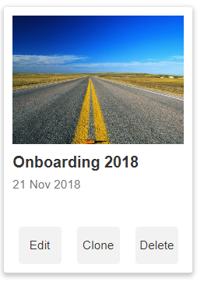
Learning Paths
Here is a sample Learning Path created specifically for one person. Screenshots that follow will show both the Admin view and the Learner view.
A Learning Path as seen by an Admin in the Learning Path section of the Admin Settings menu:

Slide 16
Learning Paths
Admin view after selecting Edit:

Slide 17
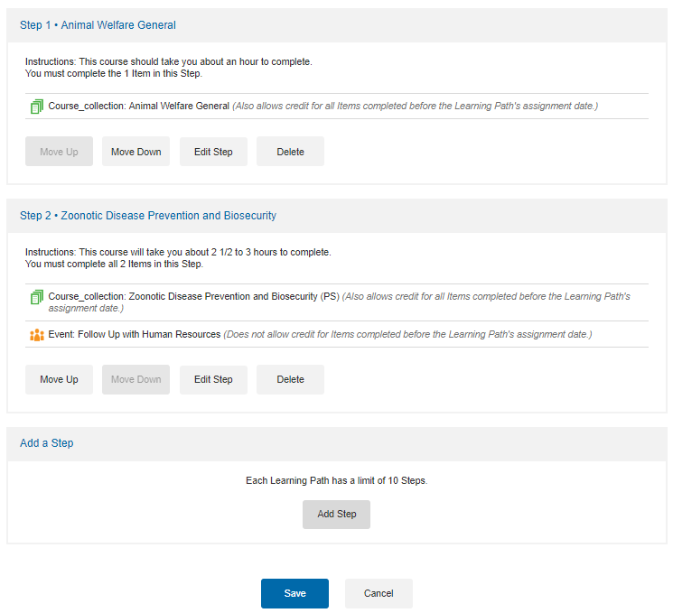
Learning Paths
Admin view – Steps section that follows the Description section:

Slide 18
Learning Paths
Admin – assigning the Learning Path using the Course Assignments tool:

Slide 19
Learning Paths
Admin – assigning the Learning Path:

Slide 20
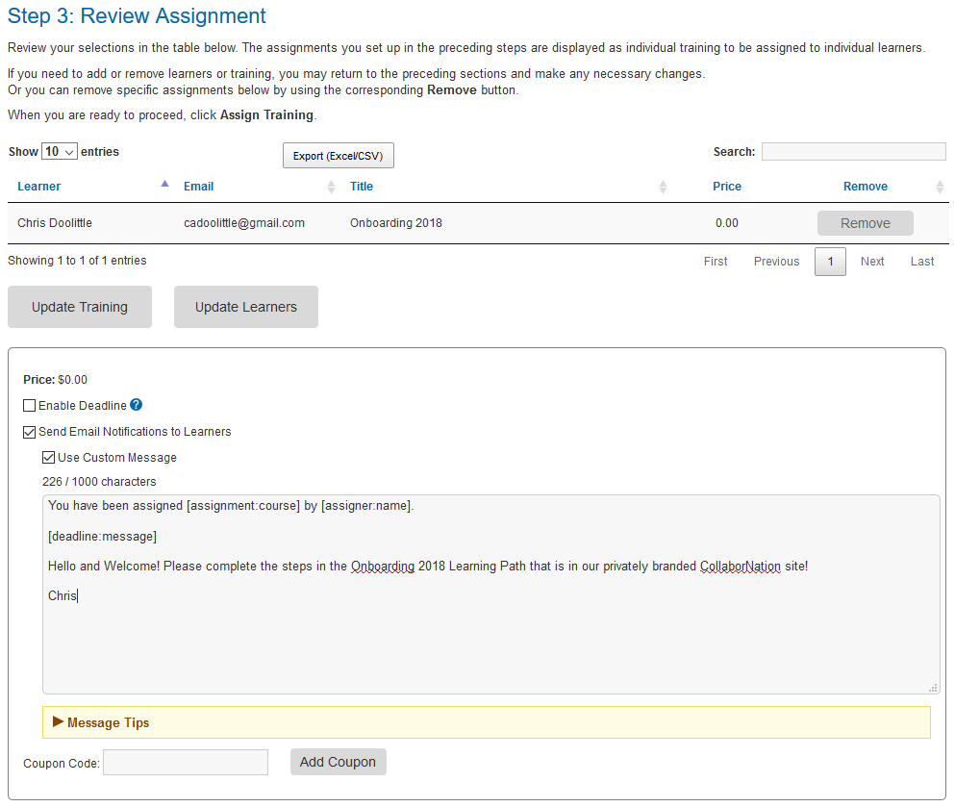
Learning Paths
Admin – assigning the Learning Path:

Slide 21
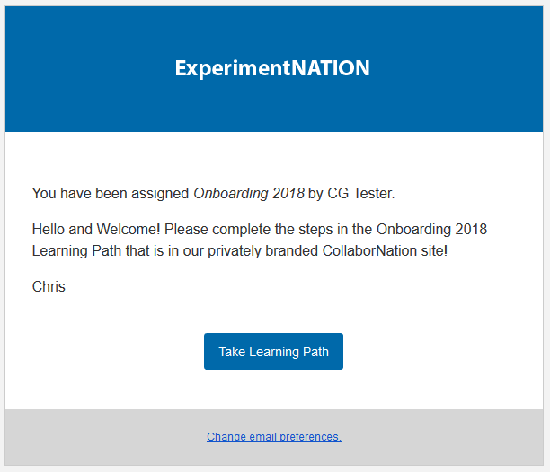
Learning Paths
Learner’s view – email notification from admin@collabornation.net

Slide 22
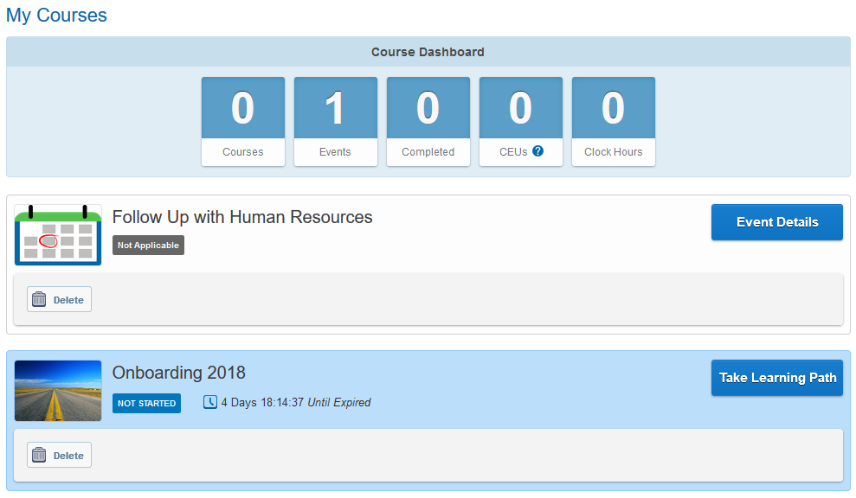
Learning Paths
Learner’s view – has logged in and is on My Courses page:

Slide 23
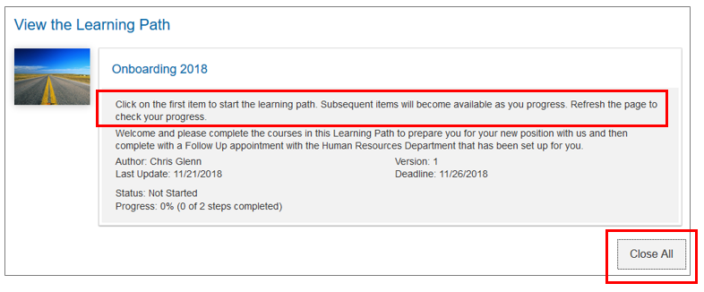
Learning Paths
Learner’s view – Introduction section:
The system adds these instructions before the language that has been added by the Admin when creating the Learning Path
The steps open up when the Learning Path is first opened but can be reduced to list view with the Close All button.

Slide 24
Learning Paths
Learner’s view – list view after Close All button has been selected:

Slide 25
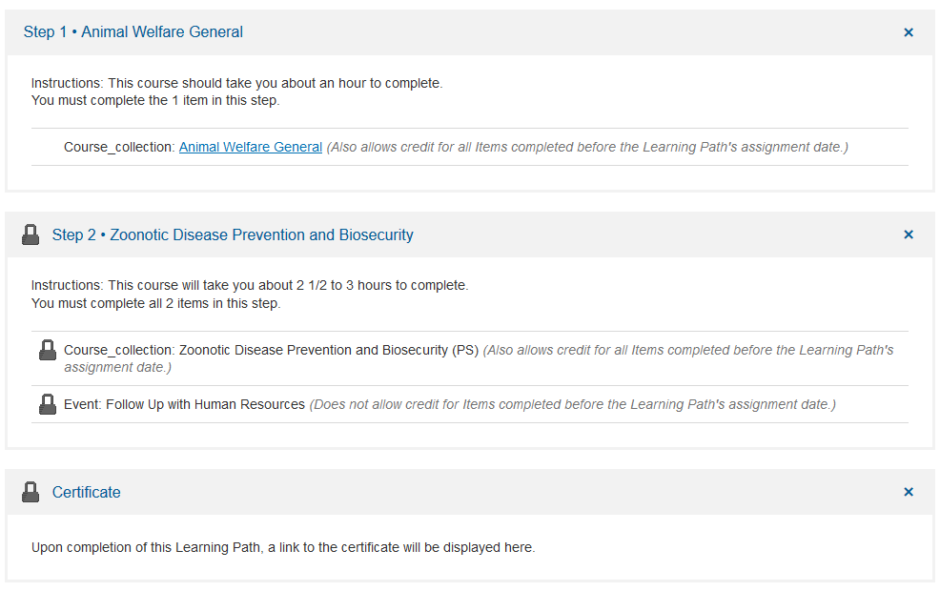
Learning Paths
Learner’s view – expanded view. Because of the way the Learning Path was set up, Step 2 is locked until Step 1 is completed.

Slide 26
Learning Paths
Learner’s view – acquiring the course in Step 1:
When a course has been assigned, it will not show in the My Courses page until the learner has opened the Learning Path and clicked on the link:

Slide 27
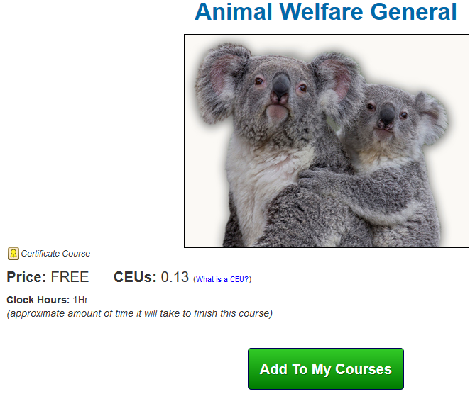
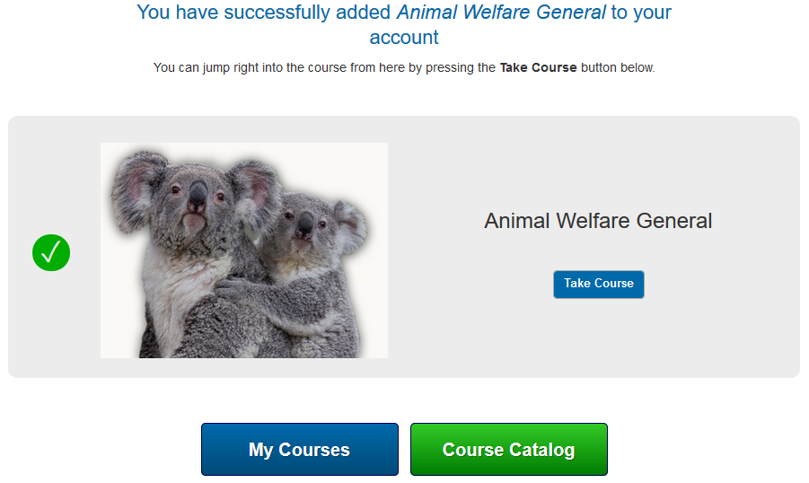
Learning Paths
Learner’s view – after clicking the link, the next step is to choose “Add to My Courses” and then the learner has the choice to begin right away or not:

Slide 28
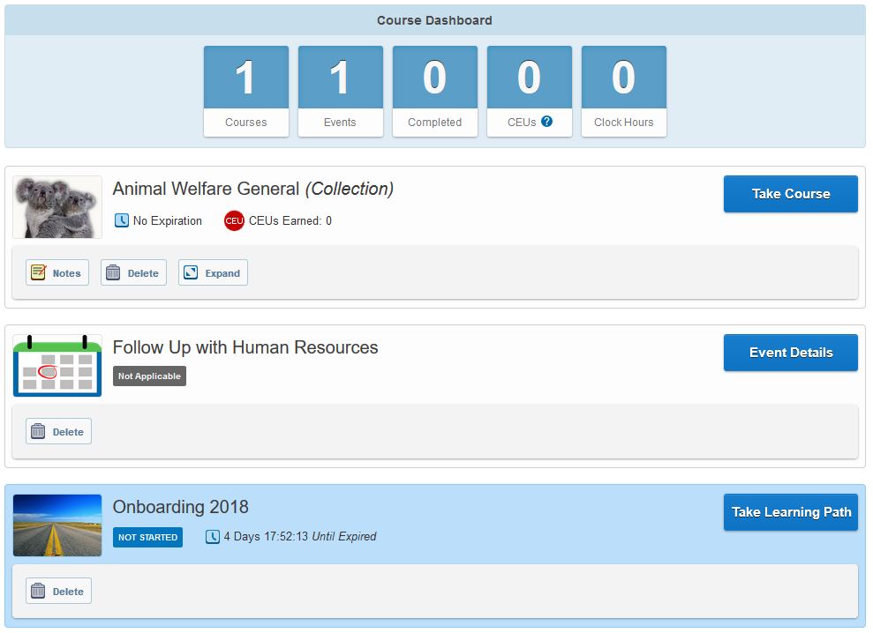
Learning Paths
Learner’s view of My Courses page after acquiring the course for Step 1:

Slide 29
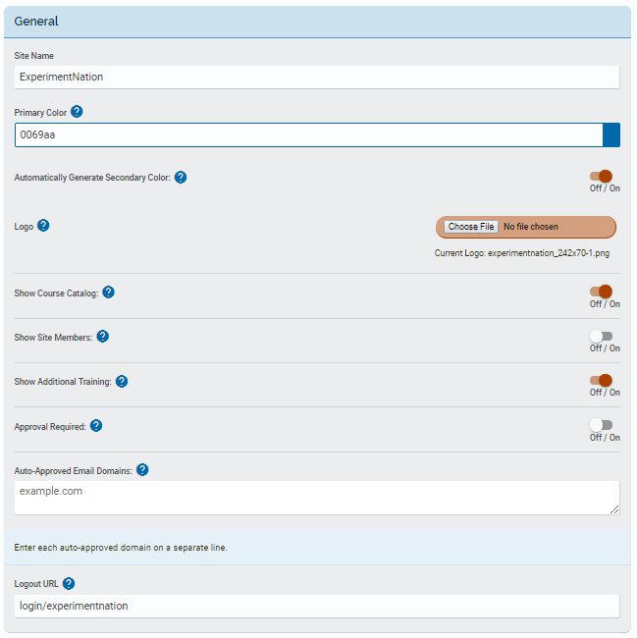
Site Building
There are many features in Site Building, giving you options to adjust settings for your site to suit your needs. What follows are quick explanations for each item, starting with the General section. (Log In and Registration sections skipped because we go over that each month.)

Slide 30
Site Building
First field in the General section - you can edit the name of the site here. This shows on the Log In and Registration pages and the Registration Message.
We choose a color when we create your site, but you can alter it here.
Default setting is for an automatic generation of a secondary color.

Slide 31
Site Building
We insert a logo when we build your site, but you can change it. Recommended dimensions for the image are 350x70 pixels.
If you want total control over what your learners take, you can hide the Course Catalog from view. Site Admins will still see it. Default setting is to show to all.
Those without Admin privileges only see a first and last name in the Site Members section, but if you want to hide it completely you can. Default is to show the listing.

Slide 32
Site Building
Individuals can load training information with this tool. If you do not want that to be an option (it shows in the Profile menu) you can turn it off. Site Admins will still be able to do batch loading.
If you are having your learners self-register, you can set your site to tag new accounts as “pending approval” (the default is to have this off).
If you have chosen to turn on the “Approval Required” function, you can list email domains to be auto-approved so that they bypass the pending stage.

Slide 33
Site Building
You can assign a link to send everyone to when they log out. The default setting is to take them back to the Log In page.

Slide 34
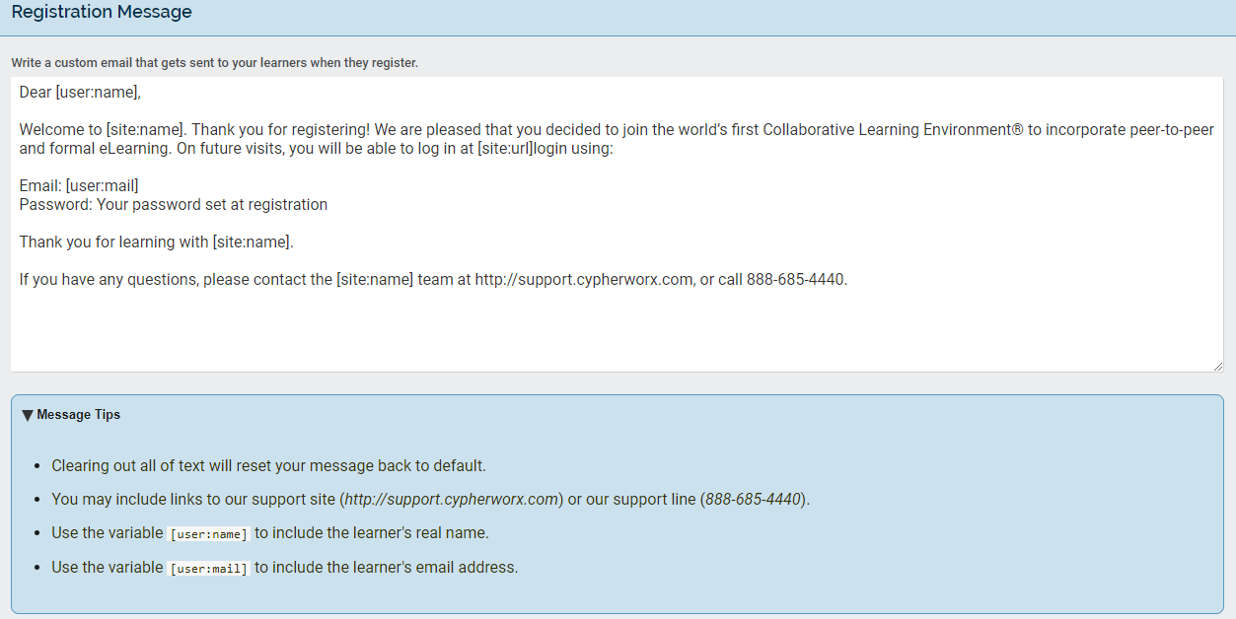
Site Building
If you have your learners self-register, they will get an email confirmation after they complete setting up their account from admin@collabornation.net
You can customize that message in the Registration Message section.

Slide 35
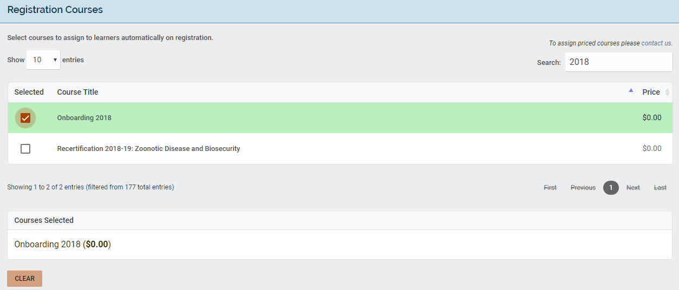
Site Building
Brand new accounts can get courses, learning paths and assessments auto-assigned in the Registration Courses section. Search for titles and check the box. More than one can be assigned.

Slide 36
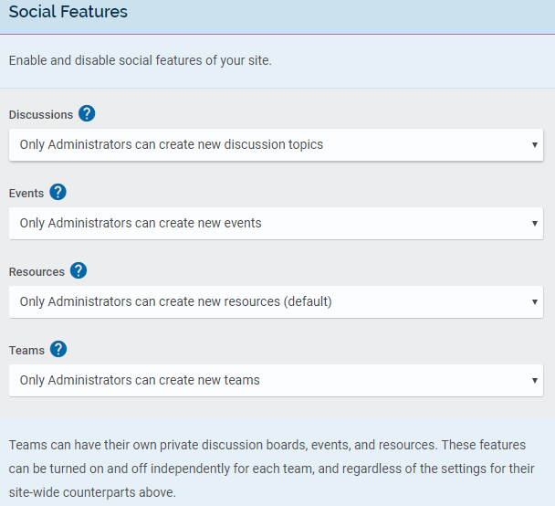
Site Building
Lastly, the Social Features section. Each of the 4 have these options at the arrow for drop down menus:
Disable
Only Admins can create
Anyone can create
And these same settings can be set independently inside of Teams.

Slide 37
Site Building
Added to the Social Features section last month (April 2019) is the feature to allow you to have Front-Facing Events – invite people to an event who do not yet have an account in your site. If they accept an Event invitation, they are taken to the Registration page to set up their account.
Visit the Support Hub to see the full article: Making Events front-facing

Slide 38
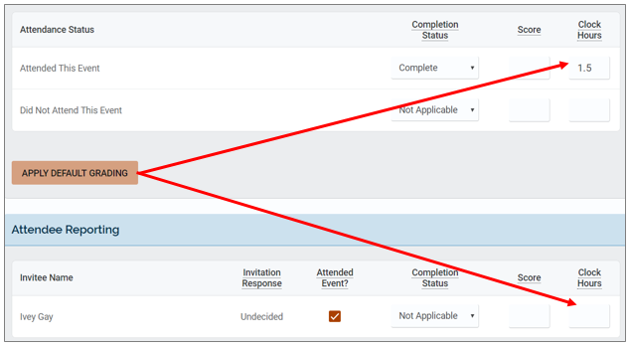
Events tip
Reminder, please do not skip the “APPLY DEFAULT GRADING” button in the Attendance Status section in After-Event Reporting. If you skip it, the information you enter in that section will not populate in Attendee Reporting when you check the box in the Attended Event? column.

Slide 39
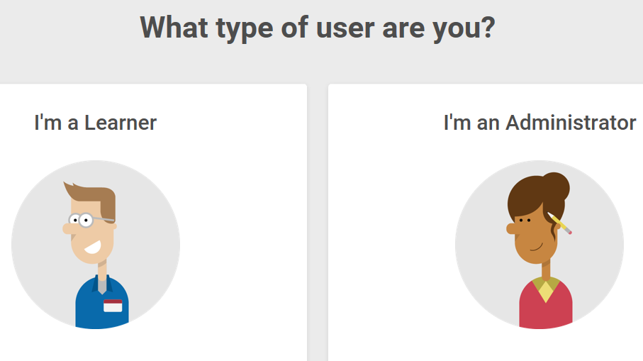
Support Hub
SUPPORT.CYPHERWORX.COM

Slide 40
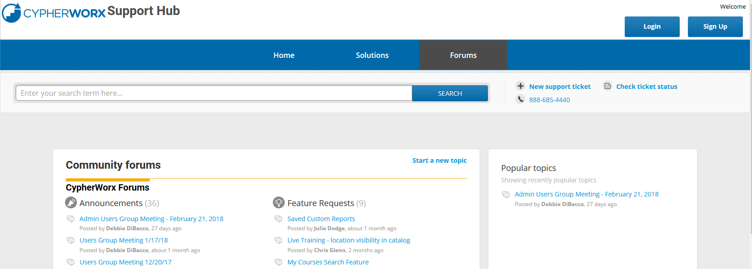
Review Meeting

Slide 41
Contact Info
Please feel free to reach out to our customer support folks after the webinar if you have more questions.
Chris Glenn – cglenn@cypherworx.com
Brett McIntosh – bmcintosh@cypherworx.com
Christopher Schramm – cschramm@cypherworx.com

Slide 42
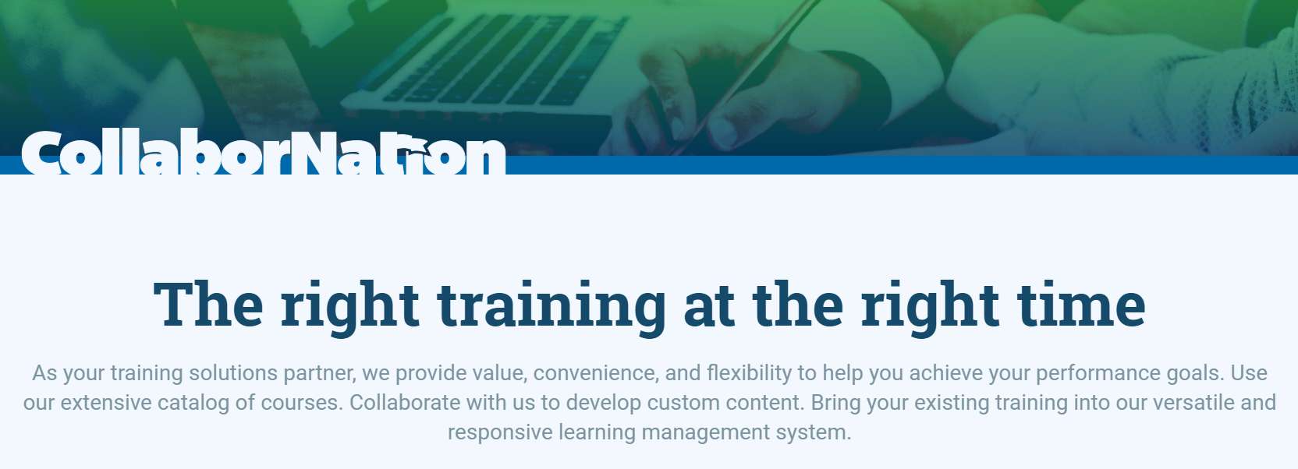
Thank you for your time today!
If there is ever anything that you would like to review or spend some time going into more detail about, please don’t hesitate to send a note to Chris G. to schedule a one-on-one session or small group session.

