Slide 1
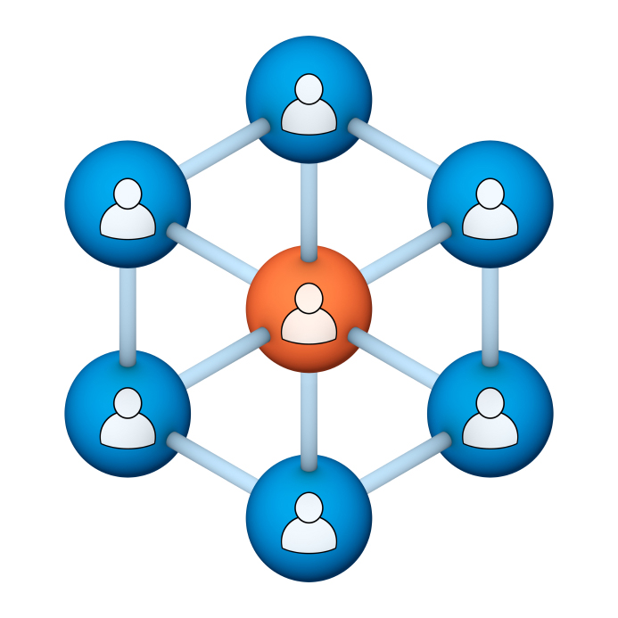
Administrators
Users Group
Meeting
12/18/19

Slide 2
Housekeeping
Using the Zoom navigation bar, click on Chat to send a question or comment:

Slide 3
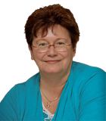
Today’s Presenter
Debbie DiBacco, Client Services CypherWorx, Inc.

Slide 4
Agenda
Registration Overview
YouTube Training Videos
Admin Course Creation
Support Hub Resources
http://en.wikipedia.org/wiki/Firefighting_in_the_United_States

Slide 5
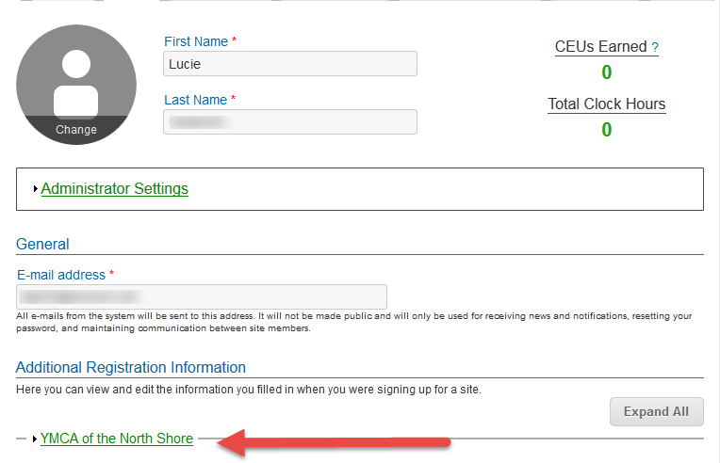
Registration
Importance of the URL:
Specific URLs for each site
Naming convention is: https://collabornation.net/ login/yoursiteinfohere
Without that URL, a customer registers incorrectly (usually into collabornation.net) and without the courses they need.
EXAMPLE: https://collabornation.net/login/ymcanorthshore

Slide 6
Registration
Importance of the URL/site link:
There are specific URLs (web addresses) for each site, and separate URLs for logging in and for registering (new account creation).
Find the unique URLs for your site in Site Building, in the General section after you select the green shield from the menu at the left edge of your screen:

Slide 7
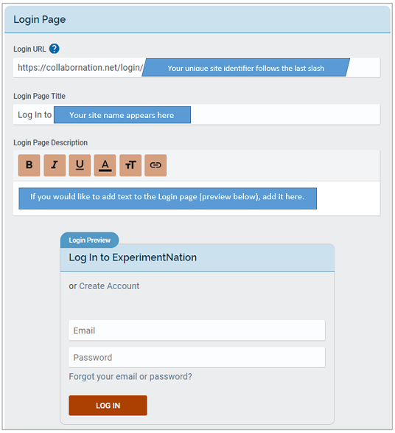
Login URL
After you select
you will see several sections and a “Save Changes” button underneath all of them.
At the top of the Login Page section you will see your unique link.

Slide 8
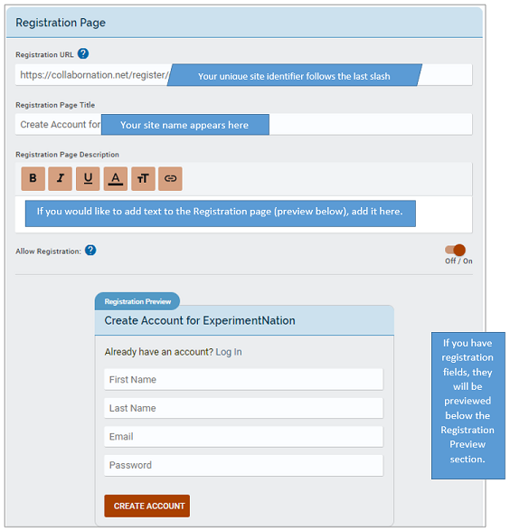
Registration URL
Below to the right is the Registration Page section and above it is a larger picture of the unique link field.
Remember, both the login URL and the registration URL will always begin with:
https://collabornation.net/

Slide 9
Training Videos
25:36 minute video
CollaborNation Site Redesign
A quick look at our site redesign
https://support.cypherworx.com/solution/articles/4000137266-collabornation-site-redesign
48:39 minute video
Admin Users Group Meeting – February 21, 2019
Mike Maether gives a tour of the redesign for Site Administrators
https://www.screencast.com/t/oaoysdg4ef
2:44 minute video
Maximize Employee Performance With Assessments
A quick look at our new Assessment Feature
https://www.youtube.com/watch?v=gi5qzVlPK2Q&t=34s
7:18 minute video
Learning Management System
Details how to take courses, participate in discussions, add events and upload resources. Admins can see how to use the reporting features, course assignment options and our DIY Course Creation tool.
https://www.youtube.com/watch?v=cOrfDxQdEY4
10:41 minute video
CollaborNation Create-a-Course (DIY) Tutorial
Details the step by step process on how to turn your existing material into an online course.
https://www.youtube.com/watch?v=cX4AXHe5Yak

Slide 10
Admin Assistance
10 Minutes - Site tools overview: https://www.screencast.com/t/8Utfj0D3GOHC
Support Hub documents: An overview of all the tools with links to the supporting articles can be found here: https://cypherworx.freshdesk.com/a/solutions/articles/4000151538

Slide 11
Courses You Create
If you are creating your own courses using a course creation software such as Articulate Storyline or Articulate Rise and need us to load your course for you, we need to have the answers to the following questions.
Course title
Are there prerequisites (if there are, then they'd need to be supplied as well)
Is there an image that will show up when someone takes the course? Is so, I'll need that in jpg form.
What is the Course Availability? (This is how long - in weeks - a client has to take the course).
Course length (how long in hours)
Course Description
What catalog you want the course to go in?
If there is a test, what's the mastery score
If there is a certificate, does it need to populate on "passed" or "completed"
If there is a quiz, please provide me with the answers.

Slide 12
Best Practice Accounts
…one account…one account…one account…one account…one account…one account…
We recommend that site administrators adopt the mantra above!
It will make your life easier when using the Reporting feature to look up course results or even to get an accurate count of how many learners you have registered in your site.
Remind your learners that each person can access their own profile to change and/or fix the email address associated with their account and also to change their own password.
The catch is that they need to be logged in to do that and when they forget their login information they tend to create a new account instead of contacting either you, the site admin, or our customer service department.

Slide 13
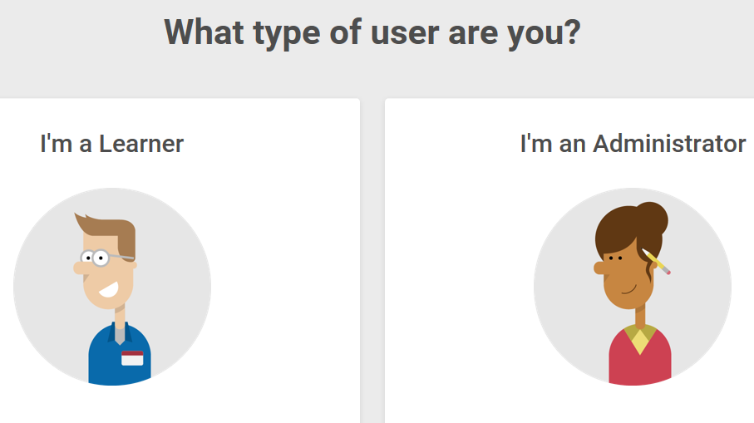
Support Hub
SUPPORT.CYPHERWORX.COM

Slide 14
Review Meeting

Slide 15
Contact Info
Please feel free to reach out after the webinar if you have more questions.
Debbie DiBacco – ddibacco@cypherworx.com

