Slide 1
Administrators
Users Group
Meeting
4/17/20

Slide 2
Housekeeping
Using the Zoom navigation bar, click on Chat to send a question or comment:

Slide 3
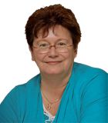
Today’s Presenter
Debbie DiBacco, Client Services CypherWorx, Inc.

Slide 4
Agenda
Registration Overview
YouTube Training Videos
Admin Tools Review
Support Hub Resources
http://en.wikipedia.org/wiki/Firefighting_in_the_United_States

Slide 5
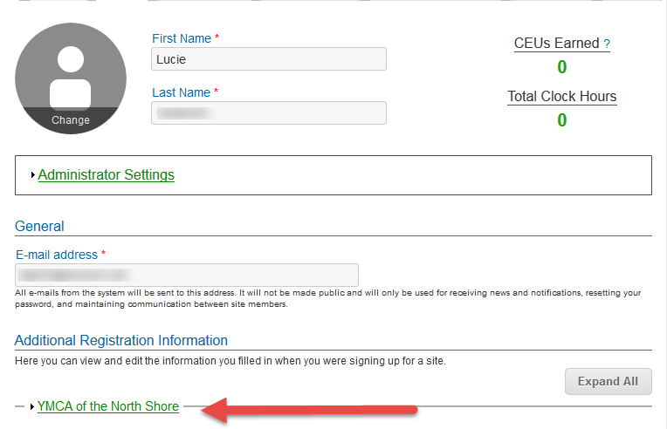
Registration
Importance of the URL:
Specific URLs for each site
Naming convention is: https://collabornation.net/ login/yoursiteinfohere
Without that URL, a customer registers incorrectly (usually into collabornation.net) and without the courses they need.
EXAMPLE: https://collabornation.net/login/ymcanorthshore

Slide 6
Training Videos
25:36 minute video
CollaborNation Site Redesign
A quick look at our site redesign
https://support.cypherworx.com/solution/articles/4000137266-collabornation-site-redesign
48:39 minute video
Admin Users Group Meeting – February 21, 2019
Mike Maether gives a tour of the redesign for Site Administrators
https://www.screencast.com/t/oaoysdg4ef
2:44 minute video
Maximize Employee Performance With Assessments
A quick look at our new Assessment Feature
https://www.youtube.com/watch?v=gi5qzVlPK2Q&t=34s
7:18 minute video
Learning Management System
Details how to take courses, participate in discussions, add events and upload resources. Admins can see how to use the reporting features, course assignment options and our DIY Course Creation tool.
https://www.youtube.com/watch?v=cOrfDxQdEY4
10:41 minute video
CollaborNation Create-a-Course (DIY) Tutorial
Details the step by step process on how to turn your existing material into an online course.
https://www.youtube.com/watch?v=cX4AXHe5Yak

Slide 7
Admin Assistance
Support Hub documents:
This link will take you to a handy PDF that has all the links to every section, in order.
https://cypherworx.freshdesk.com/a/solutions/articles/4000151538

Slide 8
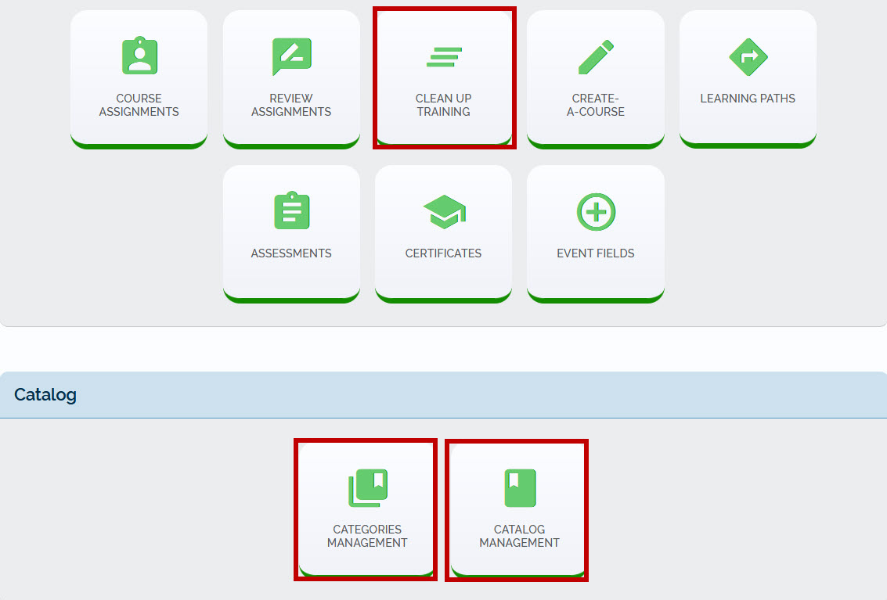
NEW TOOLS

Slide 9
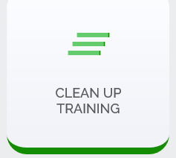
CLEAN UP TRAINING
Allows Admins to bulk remove an expiration date altogether as well as bulk set an expiration date for the requested training. The PDF in the support hub has step by step instructions.
https://cypherworx.freshdesk.com/a/solutions/articles/4000156855

Slide 10
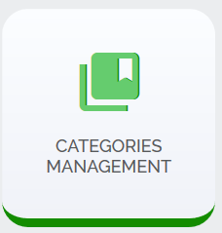
CATEGORIES MANAGEMENT
Here you may manage custom categories for your site. For completeness this section also includes categories that are enabled for the site.
https://cypherworx.freshdesk.com/a/solutions/articles/4000156305

Slide 11
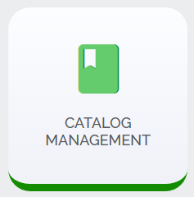
CATALOG MANAGEMENT
To save time and effort, you may provide default states that will be given to all courses displayed below.
You may then save different states for specific courses, if necessary.
https://cypherworx.freshdesk.com/a/solutions/articles/4000156303

Slide 12
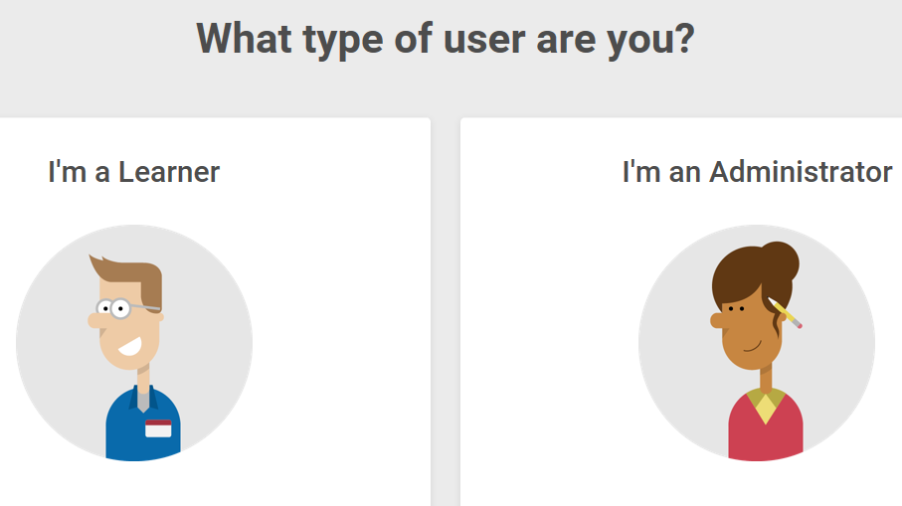
Support Hub
SUPPORT.CYPHERWORX.COM

Slide 13
Review Meeting

Slide 14
Contact Info
Please feel free to reach out after the webinar if you have more questions.
Debbie DiBacco – ddibacco@cypherworx.com

